Slide 1
Eli Chandler Sprint 002
Apr 26 – May 10
Work hard rating 3/5

Slide 2
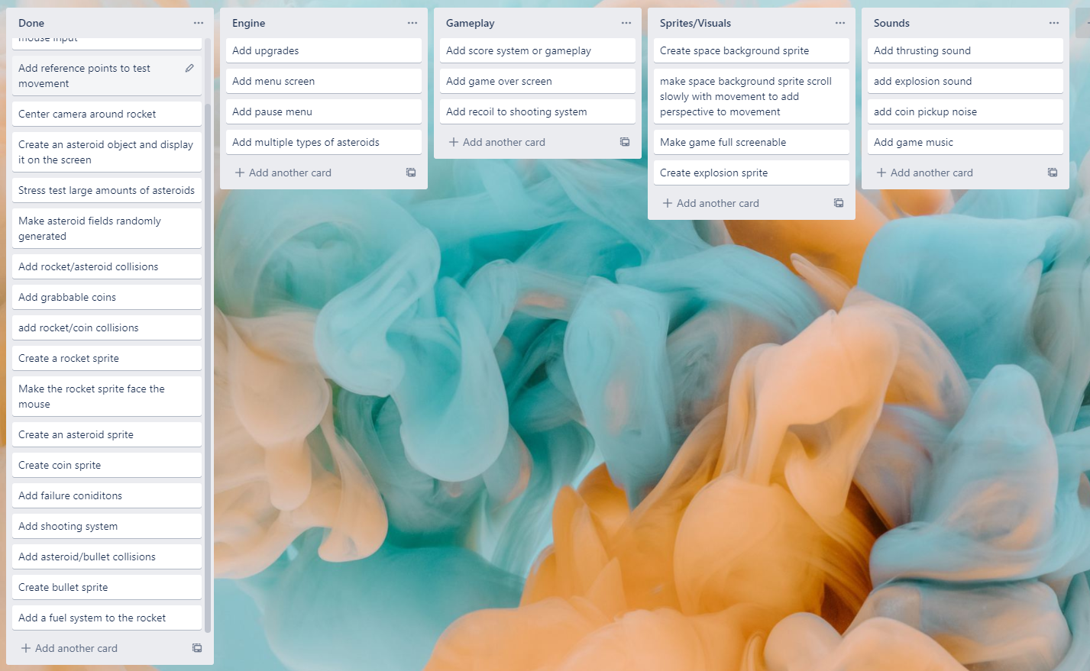
KANBAN Board at the start of the sprint

Slide 3
Sprint reflection and summary
I think that I could have accomplished more during this sprint, but the features I added were good for aesthetic purposes and for the future gameplay of the game, multiple types of asteroids i.e fuel & gold asteroids will help make the game more engaging and exciting, because there will be more things to learn and more ways to play.

Slide 4
Major changes and achievements
During this sprint I added a type variable to the asteroid class, the way the type is a string that describes what type of asteroid the Asteroid object is, different types of asteroids have different sprites and do different things when they are hit by a bullet or hit by the spacecraft. The first types of asteroids I am thinking about adding are coin asteroids, fuel asteroids and regular asteroids.
I also added an explosion animation when asteroids are hit by the bomb or the bomb explodes after not hitting anything, this makes the game world feel more reactive and gives shooting asteroids a much more satisfying feeling.
I also made the gun have a tiny amount of recoil on each shot, this adds more gameplay because if the rocket is out of fuel the player can still use the recoil to manouver and get back to base, however it is more challenging. I think this adds a fun skill based aspect to the game and adds intense situations

Slide 5
Brief description of your testing
To test the asteroid types I tried using strings such as ‘coin’ and ‘fuel’ when spawning asteroids in the game, and than in the on_hit function I printed the asteroid type to confirm the types were working correctly, this way I can check the type when they are hit and perform different actions.
For the explosion animations I made a new class and gave it an age variable and made it check how many frames of animation their were, than used that to determine how often to change frames, this way regardless of how long my explosion animation is it will still take the same amount of time for it to disappear.

Slide 6
testing
Statement | Expected output | Actual output
asteroid = Asteroid(type = ‘coin’) def on_hit(self): print(self.type) | ‘coin’ | ‘coin’
asteroid = Asteroid(type = ‘fuel’) def on_hit(self): print(self.type) | ‘fuel’ | ‘fuel’

Slide 7
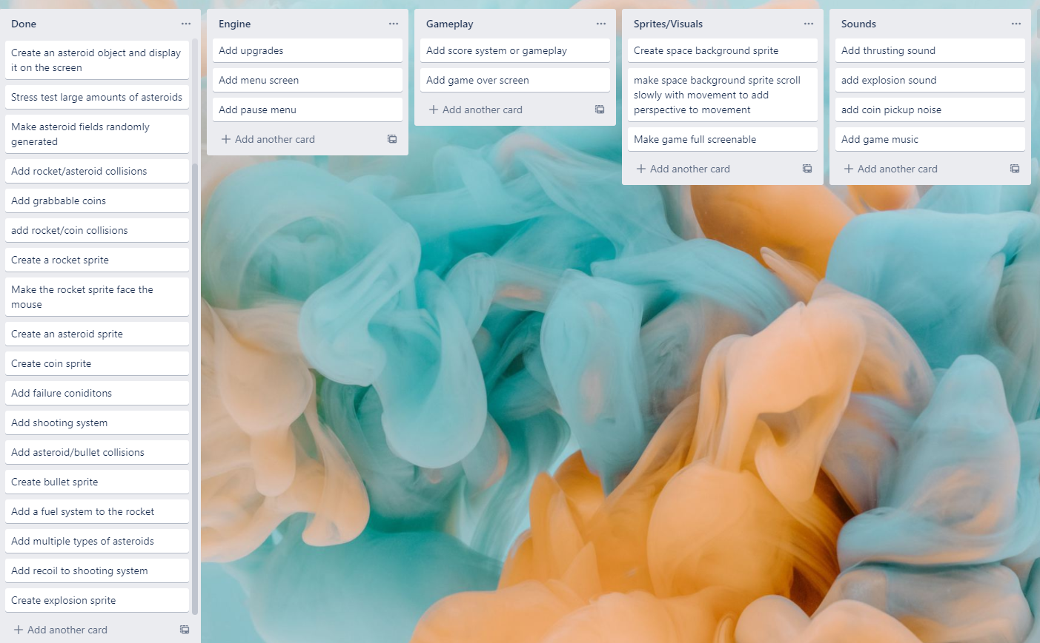
KANBAN Board at end of the sprint

Slide 8
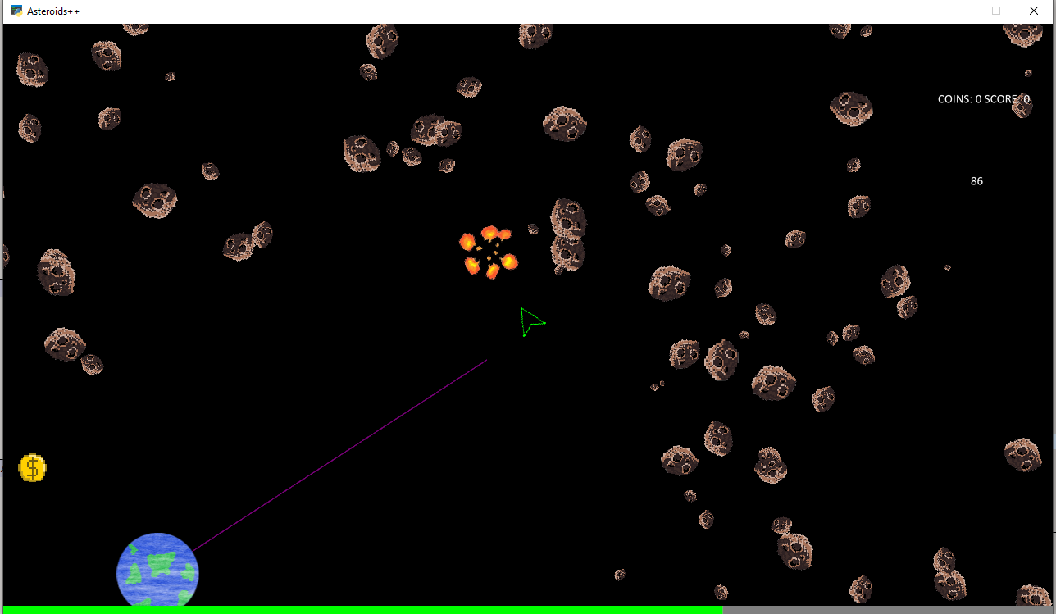
Screenshot of game at the end of the sprint

Slide 9
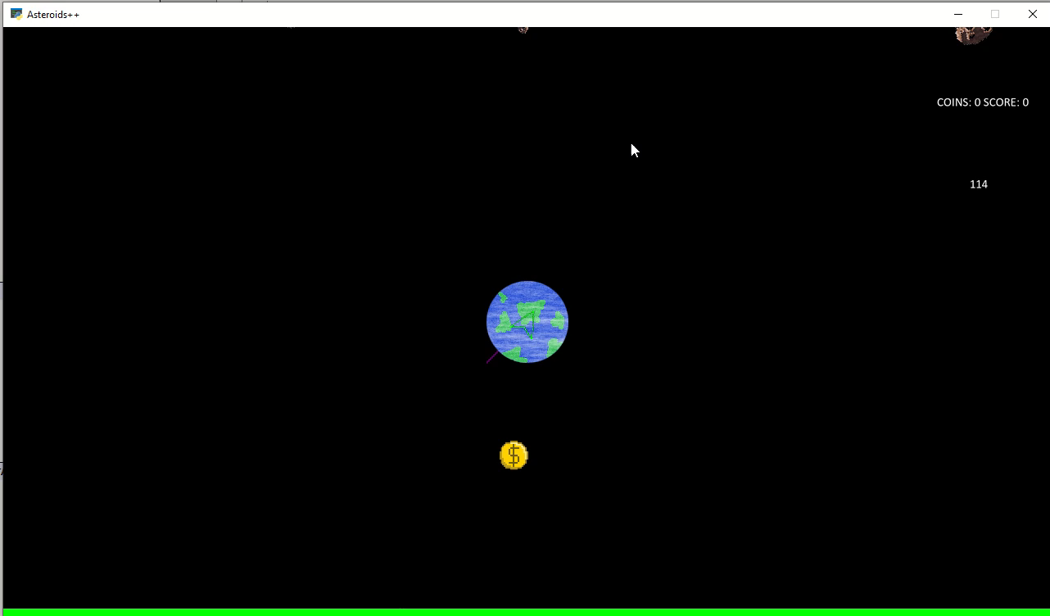
Video of the game at the end of the sprint

Slide 10
Notes for next time, future improvements
I think I should improve my class structure and have a class for any object floating in space such as rockets, asteroids and anything else,
(its possible the arcade.Sprite object will suffice) but than add an additional class for each type of asteroid I want to have with the original asteroid class as a parent, such as an individual class for coin and fuel asteroids instead of a type variable. This will depend on how much the functionality differs between asteroids wether or not I actually do it.

